Slide 1
Integrated ID Card Access Control and Attendance System
NAME: Khadija Tukur Jamil
ID: BU/22A/IT/6097
DATE: 27th January 2025

Slide 2
INTRODUCTION
The Integrated ID Card Access Control and Attendance System is designed to address the inefficiencies and security challenges in traditional attendance and access control methods. This project aims to develop a secure, automated solution for managing access to restricted areas and tracking student attendance in real-time. By replacing manual processes with an integrated system, it enhances security, reduces errors, and improves operational efficiency in academic environments.

Slide 3
Statement of problem
Baze University, like many other educational institutions, faces significant challenges in ensuring the security of its premises and the accurate tracking of attendance for students, faculty, and staff. The current methods of access control, which may involve manual checks or outdated systems, are inadequate in addressing the university’s growing needs. The proposed Integrated ID Card Access Control and Attendance System aims to resolve these challenges by providing a secure and reliable method for managing access to university facilities and accurately tracking attendance.

Slide 4
OBJECTIVES
Implement QR Code or smart card technology to control access to restricted areas within Baze University
Integrate the system to automatically log entry times for accurate attendance records.
Reduce unauthorized access and improve overall campus security.
Develop a user-friendly interface for managing access and attendance records

Slide 5
Significance of study
This project will help enhance campus security, improving operational efficiency, and supporting the university's growth. In an era where insecurity is a growing concern in Nigeria, this project provides a crucial solution to safeguarding students, staff, and university property.

Slide 6
Literature Review
Author | Methodoloy | STRENGTH | WEAKNESSES
Jain et al. (2011) | Biometric systems (fingerprint, retina) | Highly secure; low likelihood of duplication | High implementation costs; raises privacy concerns
Kim et al. (2014) | Fingerprint-based systems in academia | Enhanced security and efficient attendance monitoring | May require regular maintenance to ensure accuracy
Wright (2014) | Smart card-based systems | Secure and flexible for multiple applications | Risk of card theft unless multi-factor authentication is used
Bell & Coates (2019) | Smart card systems with encryption | Provides enhanced security through encryption | Risk of theft without additional security layers

Slide 7
Methodology
AGILE METHODOLOGIY
Agile method is an iterative and incremental approach that allows Frequent feedback cycles to ensure alignment with requirements and delivering functional components early.

Slide 8
Why Agile Method?
Flexibility to adapt to changes.
Encourages collaboration between developers and stakeholders.
Supports continuous improvement of the system.
Enables faster identification and resolution of issues.

Slide 9
Languages and FRAMEWORKS
Backend: Python, Django
Frontend: HTML, CSS, JavaScript
Tools: Mailtrap.io for notifications, Ngrok for secure tunneling
Database: MySQL
Others: QR Code technology

Slide 10
Functional requirements
Requirement ID | DESCRIPTION
FR-01 | The system must support user authentication, allowing students and admins to log in securely.
FR-02 | The system must allow users to reset and update their passwords.
FR-03 | The system must support QR code scanning for student attendance
FR-04 | Attendance records must be updated automatically in real-time.
FR-05 | Admins must be able to view, edit, and manage attendance logs.

Slide 11
NON-Functional requirements
Requirement ID | DESCRIPTION
NFR-01 | The system must maintain at least 99% uptime during operational hours.
NFR-02 | All sensitive data, including passwords and unique codes, must be encrypted before storage
NFR-03 | The user interface must be intuitive and user-friendly for both students and admins.
NFR-04 | The system must provide a response time of less than 2 seconds for user actions, such as code input or QR code scanning.
NFR-05 | The system must log all access and attendance events for audit purposes and allow these logs to be reviewed.

Slide 12
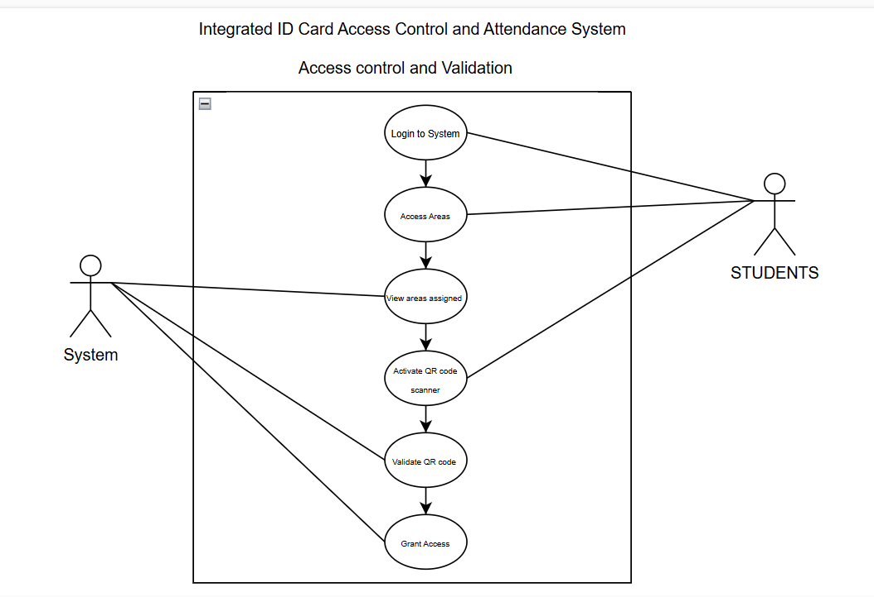
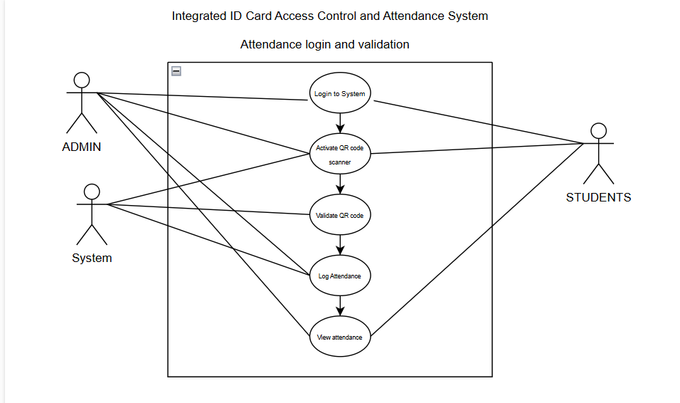
UML DIAGRAMS (USE CASES)
ACCESS CONTROL AND VALIDATION
ATTENDANCE LOGIN AND VALIDATION

Slide 13
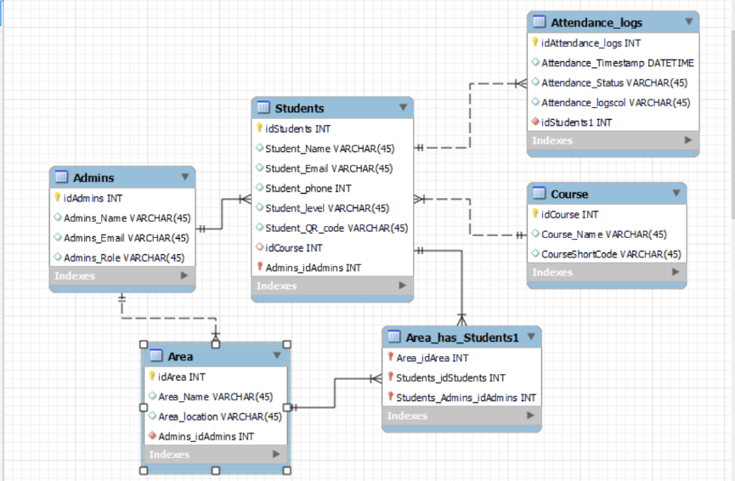
UML DIAGRAMS (ENTITY RELATIONSHIP)

Slide 14
SUMMARY OF UNIT TESTING
Test Objective | Test Steps | Expected Result | Actual Result | Pass/Fail
Authentication Module | 1. Enter valid login credentials | User is authenticated and redirected | User is authenticated and redirected | pass
 | 2. Enter invalid login credentials | Error message is displayed | Error message is displayed | pass
QR Code Scanning Module | 1. Scan a valid QR code | Attendance is logged successfully | Attendance is logged successfully | pass
 | 2. Scan an invalid QR code | Error message is displayed | Error message is displayed | pass
Attendance Logging Module | 1. Log Attendance using unique code | Attendance is recorded in the database | Attendance is recorded in the database | pass
 | 2. Attempt to log duplicate attendance | Duplicate entries are prevented | Duplicate entries are prevented | pass

Slide 15
SUMMARY OF INTEGRATION TESTING
Test Objective | Test Steps | Expected Result | Actual Result | Pass/Fail
Frontend and Backend Communication | 1. Submit valid attendance input from the frontend | Attendance data is processed by the backend | Attendance data was processed successfully | pass
 | 2. Submit invalid input from the frontend | System returns an error message | Error message was returned | pass
Database Integration | 1. Store new attendance records | Records are stored and retrievable in the database | Records were stored and retrieved successfully | pass
 | 2. Fetch assigned access areas for a student | Correct access areas are retrieved | Correct access areas were retrieved | pass
Notification System | 1. Trigger unauthorized access notification | Notification is sent to the admin via Mailtrap.io | Notification was sent successfully | pass
 | 2. Simulate notification delivery failure | Retry mechanism is triggered | Retry mechanism was triggered successfully | pass

Slide 16
SUMMARY OF SYSTEM TESTING
Test Objective | Test Steps | Expected Result | Actual Result | Pass/Fail
Student Attendance | 1. Log attendance using valid QR code | Attendance is recorded successfully | Attendance is recorded successfully | pass
 | 2. Log attendance with invalid QR code | Error message is displayed | Error message is displayed | pass
Access Control | 1. Request access to assigned area | Access is granted | Access is granted | pass
 | 2. Request access to unauthorized area | Access is denied | Access is denied | pass
Admin Dashboard | 1. Add a new course | Course is added to the system | Course is added successfully | pass
 | 2. Generate attendance report | Report is generated | Report was generated successfully | pass

Slide 17
Abstract
This project focuses on the design and implementation of an Integrated ID Card Access Control and Attendance system for Baze University. With growing security concerns and the need for efficient attendance tracking in academic institutions, this system provides a robust solution by combining QR Code technology, ID cards, and cloud-based infrastructure. The system ensures that only authorized individuals can access restricted areas while automatically recording attendance in real time. The project addresses key challenges, such as reducing unauthorized access, improving the accuracy of attendance records, and enhancing campus security. By integrating the system with existing campus management tools, such as payroll and human resource systems, the solution offers scalability and seamless operations. The study leverages best practices in access control and attendance management while addressing gaps in existing technologies, such as data privacy and cost efficiency. The results demonstrate the effectiveness of this system in improving security, streamlining administrative tasks, and promoting a safer learning environment. This project provides a practical framework for the implementation of access control systems in similar institutional contexts.

Slide 18
conclusion
The system successfully enhances access control and attendance tracking by providing a reliable and automated solution that improves campus security and operational efficiency. Comprehensive testing ensured that the system met all functional and non-functional requirements, delivering a robust and user-friendly platform. Looking ahead, future enhancements are planned, including the integration of biometric authentication and mobile notifications, to further improve functionality and user experience.

Slide 19
REFRENCES

Slide 20
Thank you

